Slide 1

BANSAL COLLEGE OF ENGINEERING MANDIDEEP
MINOR PROJECT
ON
FACULTY DATA MANAGEMENT
Presented By:-
Aman (0127cs211009)
Beekesh ahirwar (1027cs211022)
Uday meena (0127cs211122)
Durgesh sahu (0127cs211029)
Guided by:-
Prof. Sapna lonare
(Dept of CSE)

Slide 2
Abstract
The main conceptual idea of the “ Faculty data Management” is based on a web application that specifies the faculty details. In prior days managing faculty details, a schedule was entirely based on manual effort and it is a time-consuming process.
The “Faculty Data Management System” has been proposed to overcome such problems. This emphasizes a continuous and comprehensive upgrading of visualizing the required changes in the modernized technology.

Slide 3
Introduction
“Faculty Data Management System” is web based application which store the data of faculty of different colleges. This system helps the student to view the details of faculty online. The “Faculty Record Management System” can be entered using a username and password. It is accessible by an administrator.
Administrator only they can add data into the database. The data can be retrieved easily. The data are well protected for personal use and makes the data processing very fast. This system objectives of easily & maintainable information.

Slide 4
Purpose
The goal of any system development is to develop and implement the system cost effectively; it most suited to the user’s analysis is the heart of the process. Analysis is the study of the various operations performed by the system like as (add, update, delete faculty and college details) and maintain relationship within through the system. During analysis, data collected on the files, decision points and transactions handled by the present system.
The Faculty Management System can be entered using a username and password. It is accessible by an administrator.
Administrator only they can add data into the database. The data can be retrieved easily. Another purpose for developing this application is to generate the report automatically.

Slide 5
Scope
The “Faculty Data Management System” of the organization is developed to overcome the most of the problems occurring in the manual system by computerizing the existing system.
In any manual system if we take, the main problem arising is to maintain the number of records and finding a particular record.
Some of the features of the proposed system are given below:
Maintaining the Data for Faculty details.
Getting the information.
Removal of Data Redundancy
Data Consistency.

Slide 6
Project Modules
In “Faculty Data Management System” we use PHP and MySQL database. This is the project which keeps records of faculty “Online College Faculty Record Management System” has one module i.e. admin.
Users:
Users can view the details of faculty.

Slide 7
Admin Module
Dashboard: In this section admin can briefly view total number of sub-admins, total number of listed colleges and total number of faculty.
Colleges: In this section, admin can manage the Colleges (add/update/delete).
Faculty: In this section, admin can manage the Faculty (add/update/delete).
Pages: In this section, admin can manage the website pages.
Account Setting: In this section, admin can do following activity.
Profile: In this section admin can update his/her profile.
Change Password: In this section admin can change his/her own passwords
Logout: Through this button admin can logout.
Forgot Password: In this section, admin can reset his/her password by using registered email id and contact number.
Note: In this project MD5 encryption method used.

Slide 8
Requirement Specification
Hardware Configuration:
Client Side
Server Side
RAM | 512 MB
Hard Disk | 10GB
Processor | 1.0 GHz
RAM | 1 GB
Hard Disk | 20GB
Processor | 2.0GHz

Slide 9
Continue.....
Software Requirement:
Client Side
Server Side
Web Browser | Google Chrome or any compatible browser
Operating System | Windows or any equivalent OS
Web Server | APACHE
Server side Language | PHP5.6 or above version
Database Server | MySQL
Web Browser | Google Chrome or any compatible browser
Operating System | Windows or any equivalent OS

Slide 10
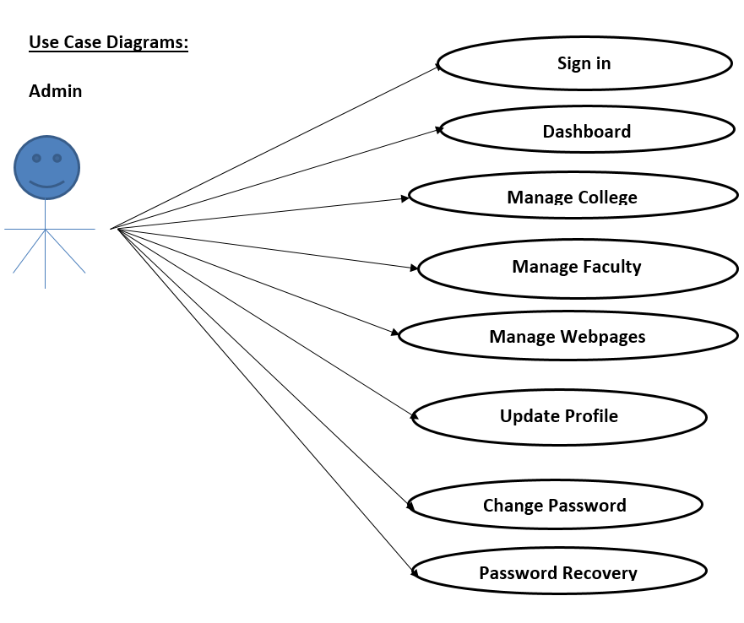
Use Case Diagram
Notes:
USECASE DIAGRAM: A Use case is a description of set of sequence of actions. Graphically it is rendered as an ellipse with solid line including only its name. Use case diagram is a behavioral diagram that shows a set of use cases and actors and their relationship. It is an association between the use cases and actors. An actor represents a real-world object. Primary Actor – Sender, Secondary Actor Receiver.

Slide 11
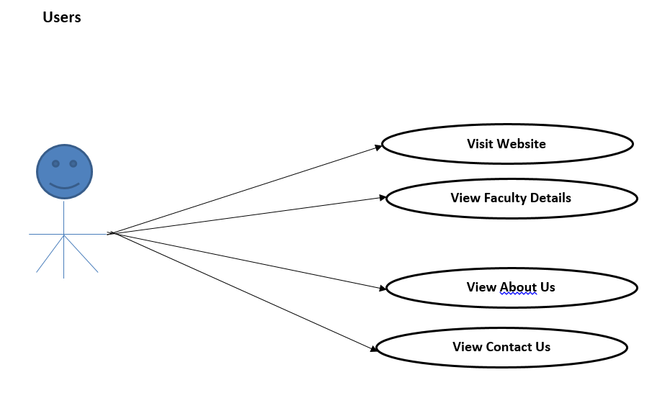
Continue…

Slide 12
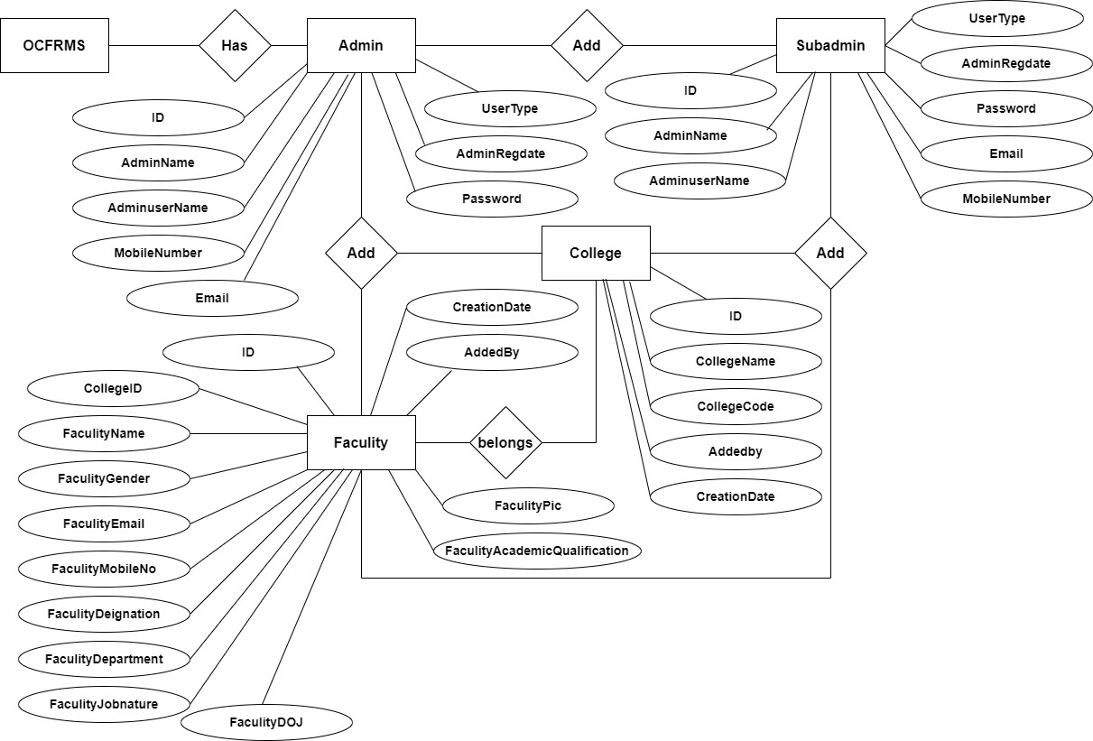
ER Diagram

Slide 13
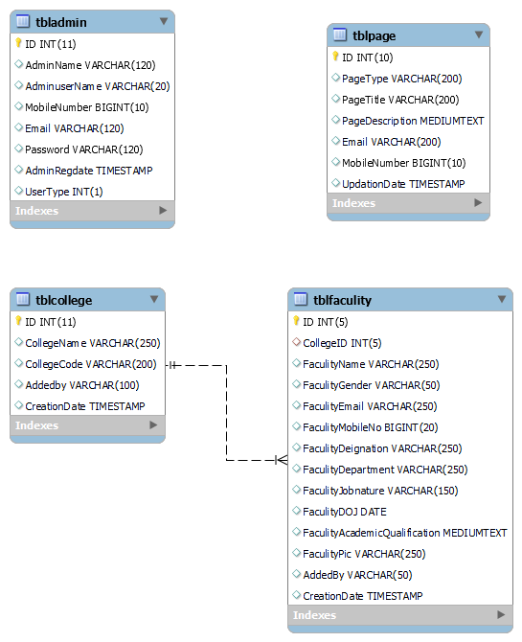
Class Diagram
Notes:
The class diagram shows a set of classes, interfaces, collaborations and their relationships.

Slide 14
Data Flow Diagrams
Data Flow Diagram
DFD graphically representing the functions, or processes, which capture, manipulate, store, and distribute data between a system and its environment and between components of a system. The visual representation makes it a good communication tool between User and System designer. Structure of DFD allows starting from a broad overview and expand it to a hierarchy of detailed diagrams. DFD has often been used due to the following reasons:
Logical information flow of the system
Determination of physical system construction requirements
Simplicity of notation
Establishment of manual and automated systems requirements

Slide 15
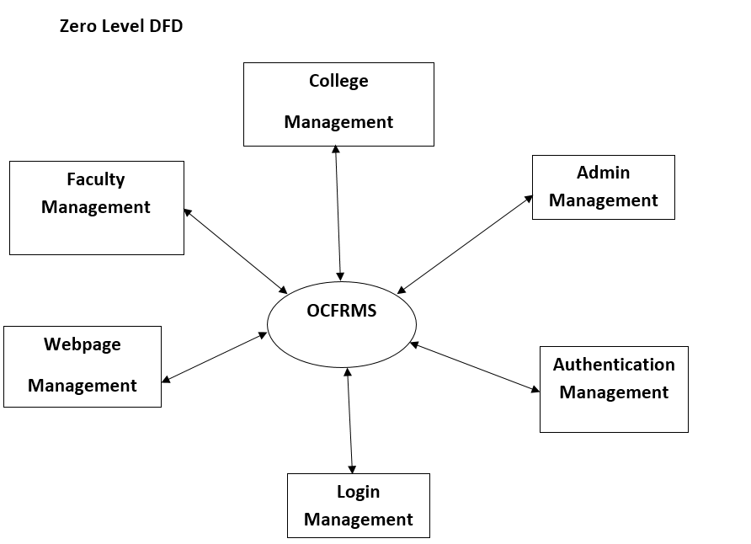
ZERO LEVEL DFD DIAGRAM

Slide 16
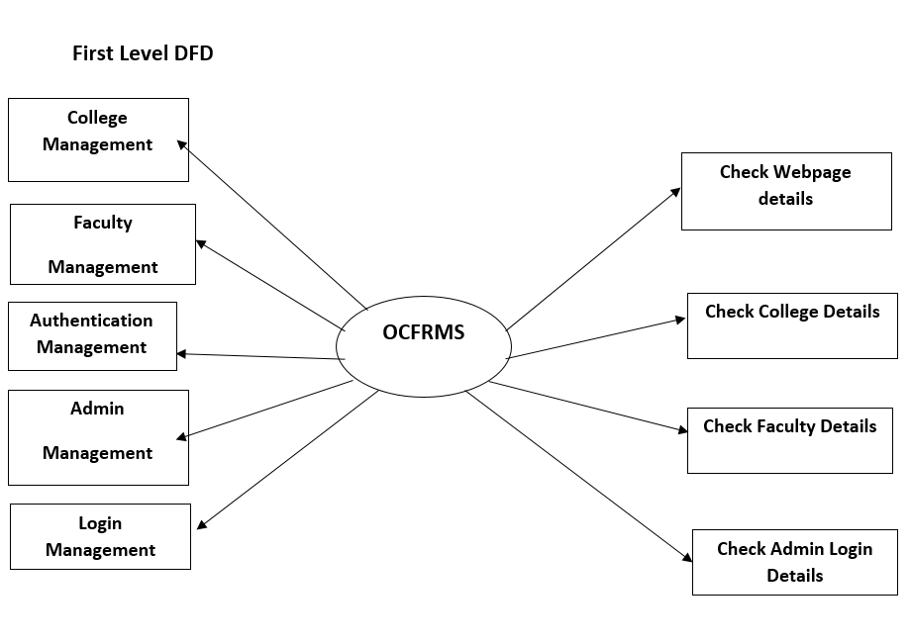
FIRST LEVEL DFD DIAGRAM

Slide 17
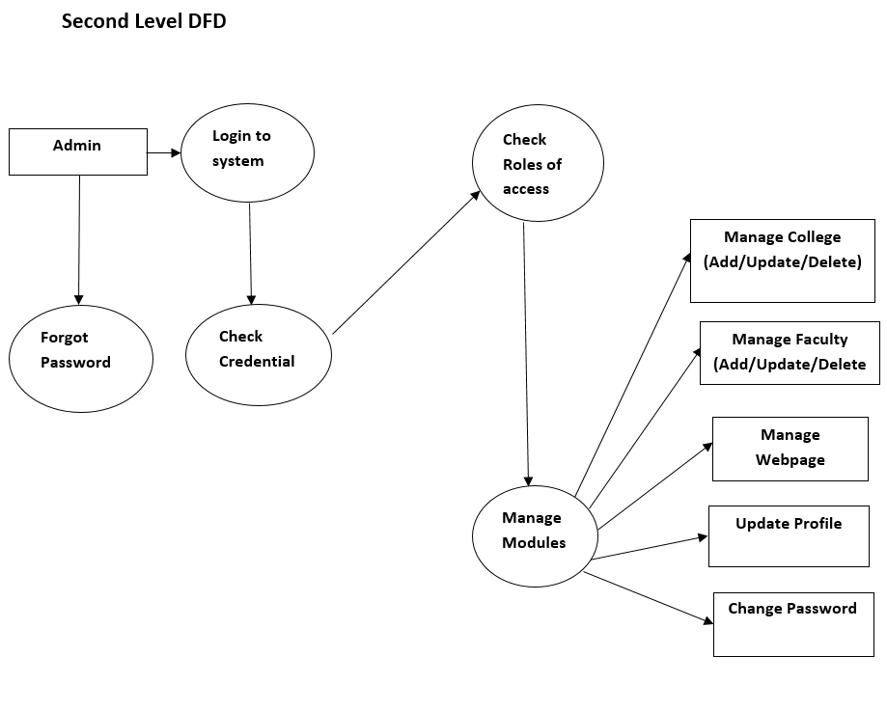
SECOND LEVEL DFD

Slide 18
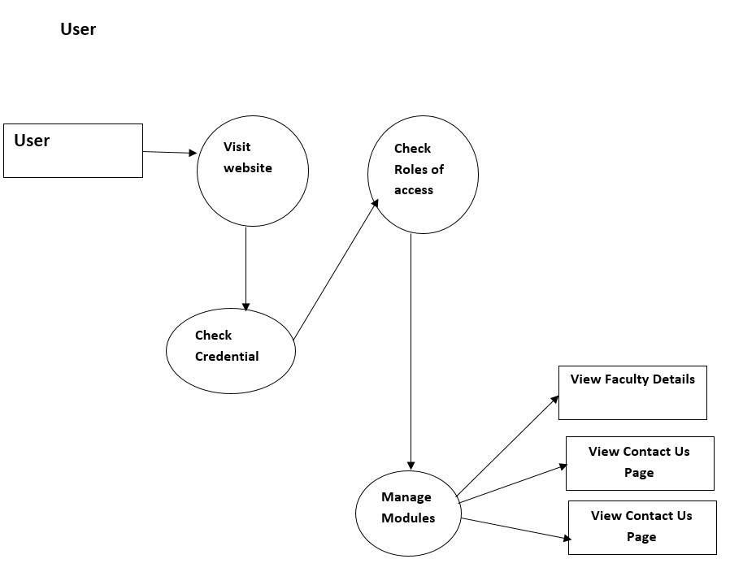

Slide 19
Implementation and System Testing
After all phase have been perfectly done, the system will be implemented to the server and the system can be used.
System Testing
The goal of the system testing process was to determine all faults in our project .The program was subjected to a set of test inputs and many explanations were made and based on these explanations it will be decided whether the program behaves as expected or not. Our Project went through two levels of testing
Unit testing
Integration testing

Slide 20
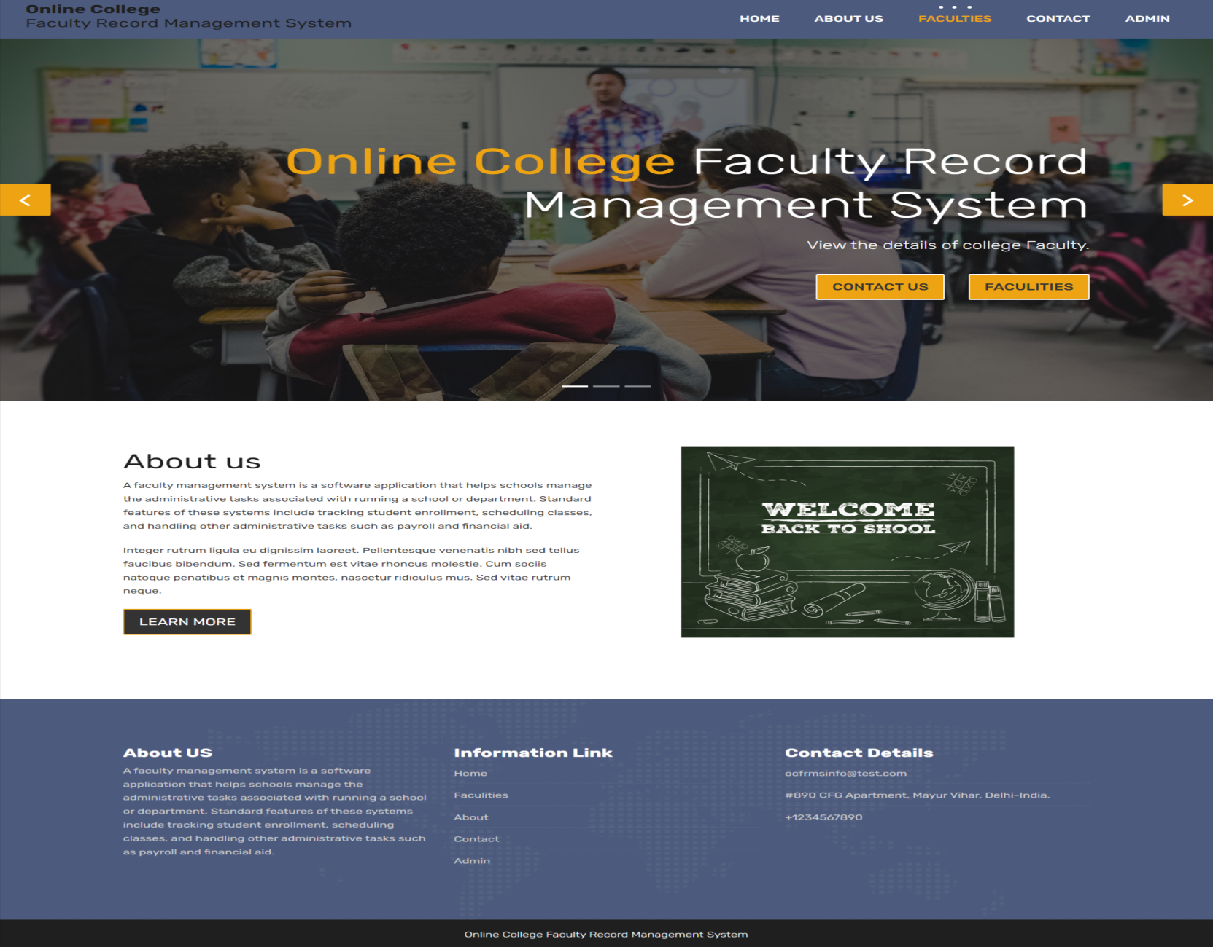
Project Screens

Slide 21
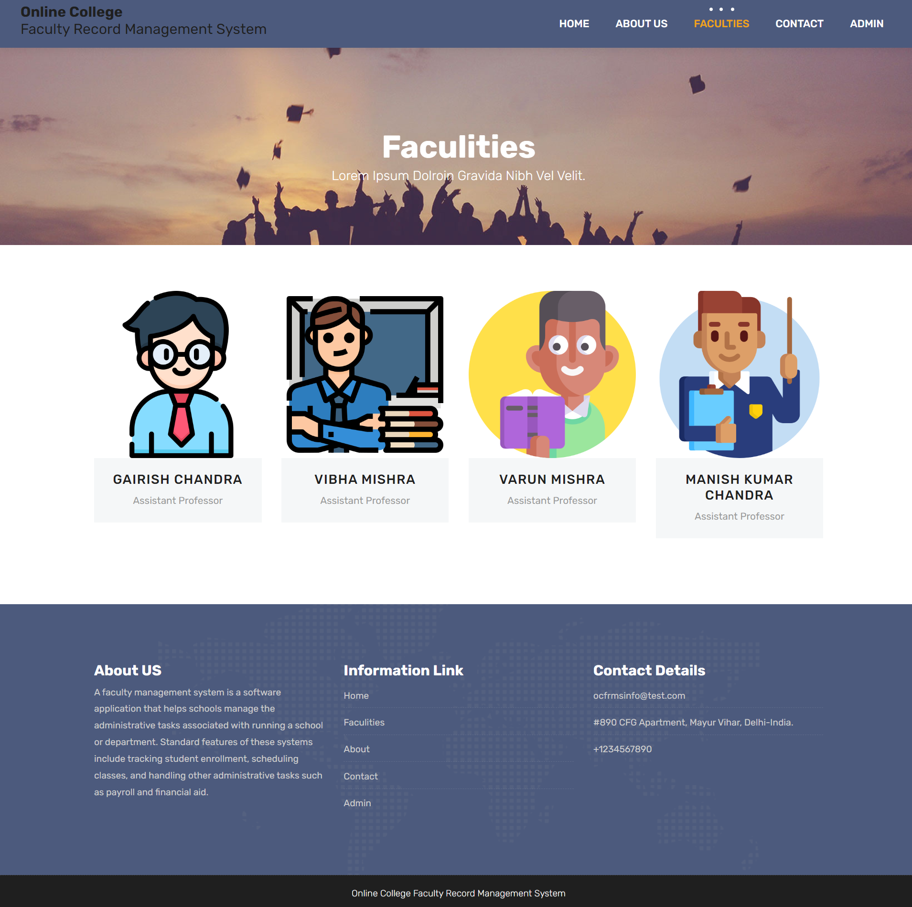

Slide 22


Slide 23
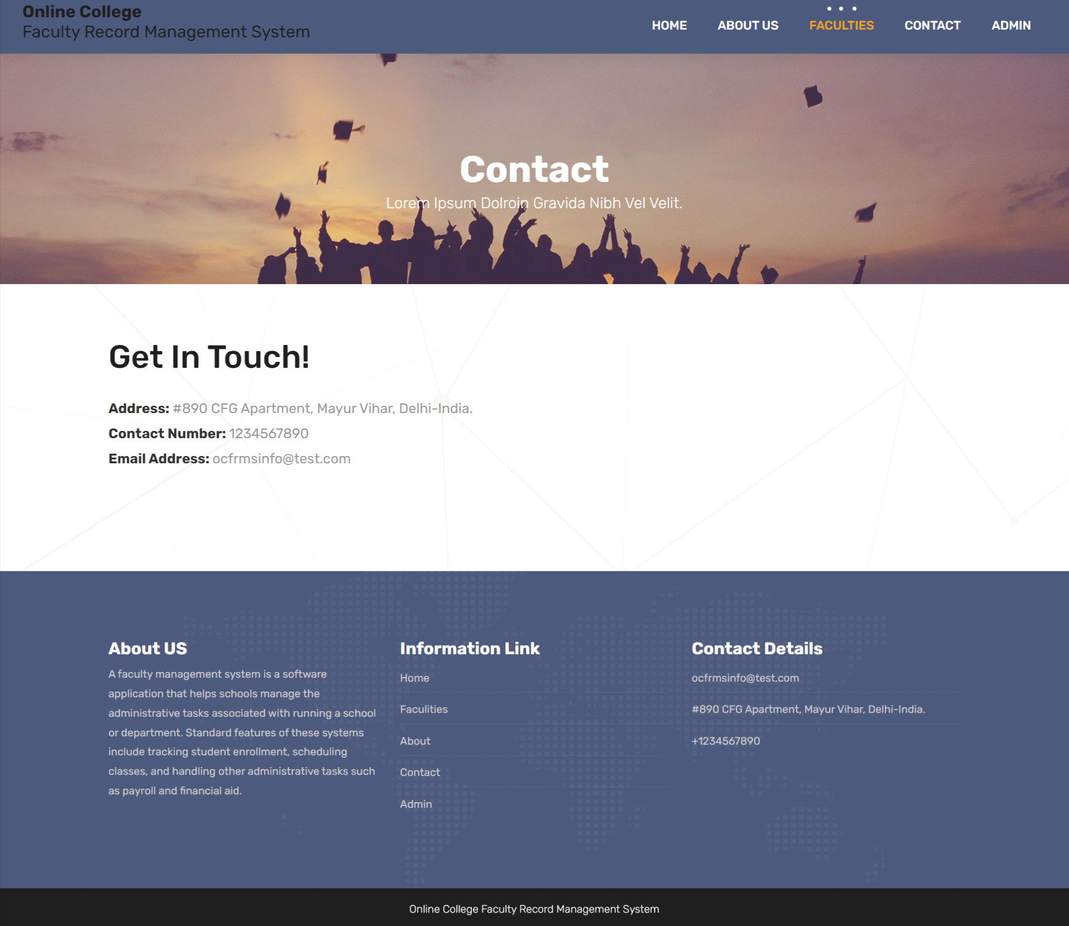

Slide 24
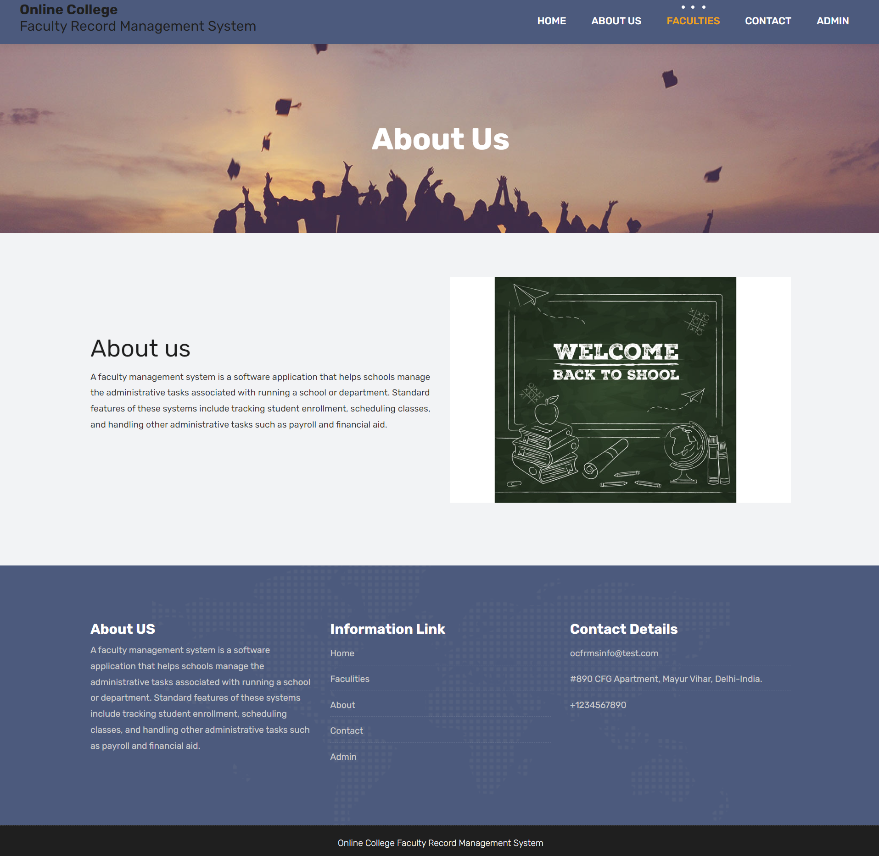

Slide 25
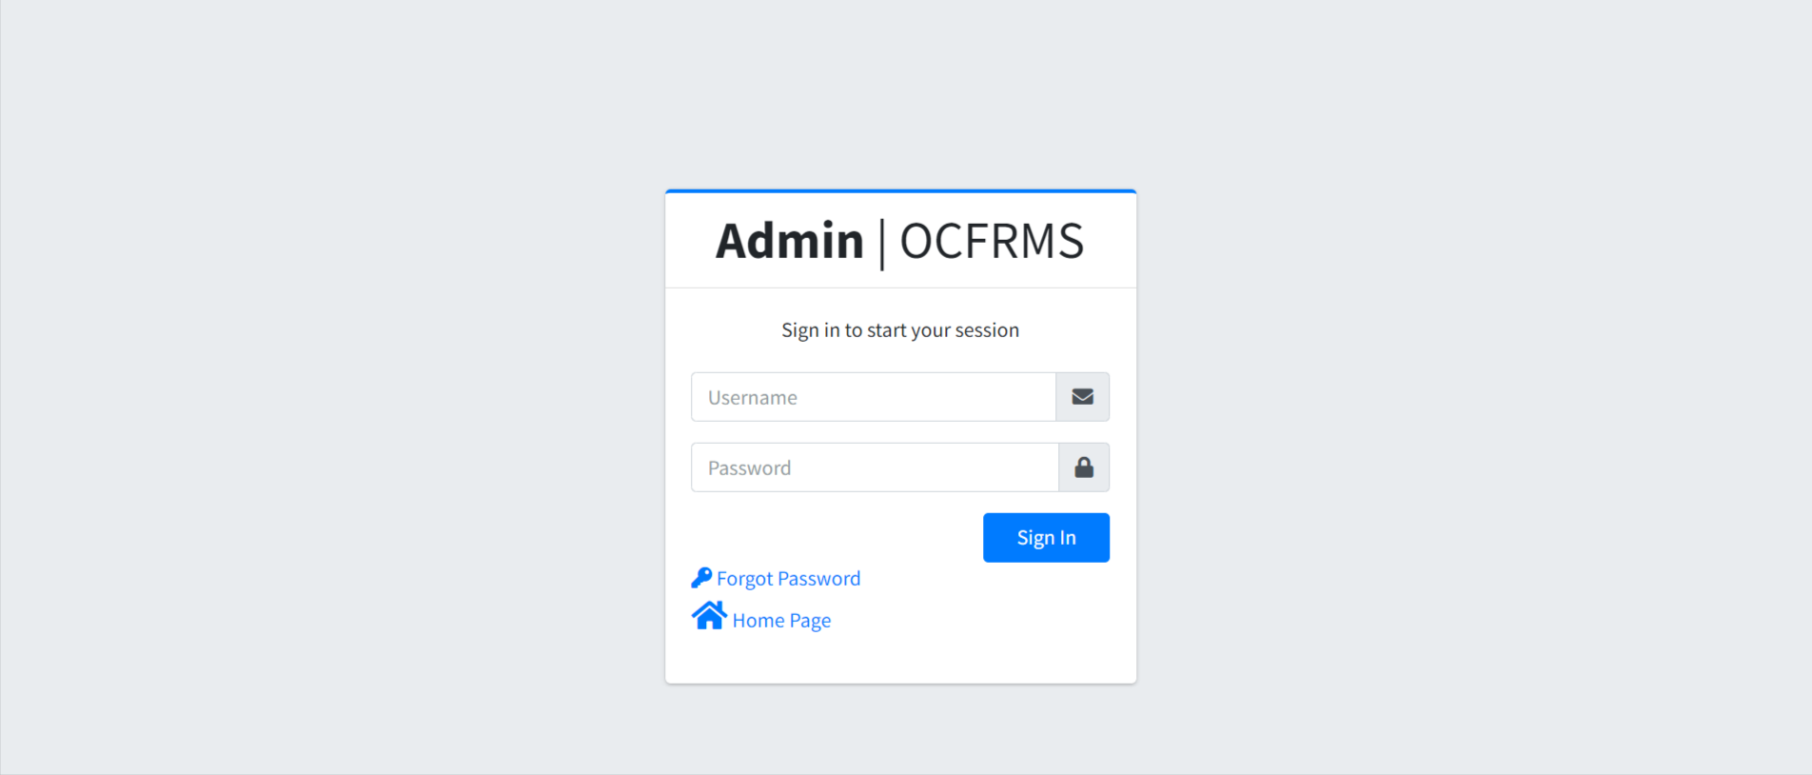
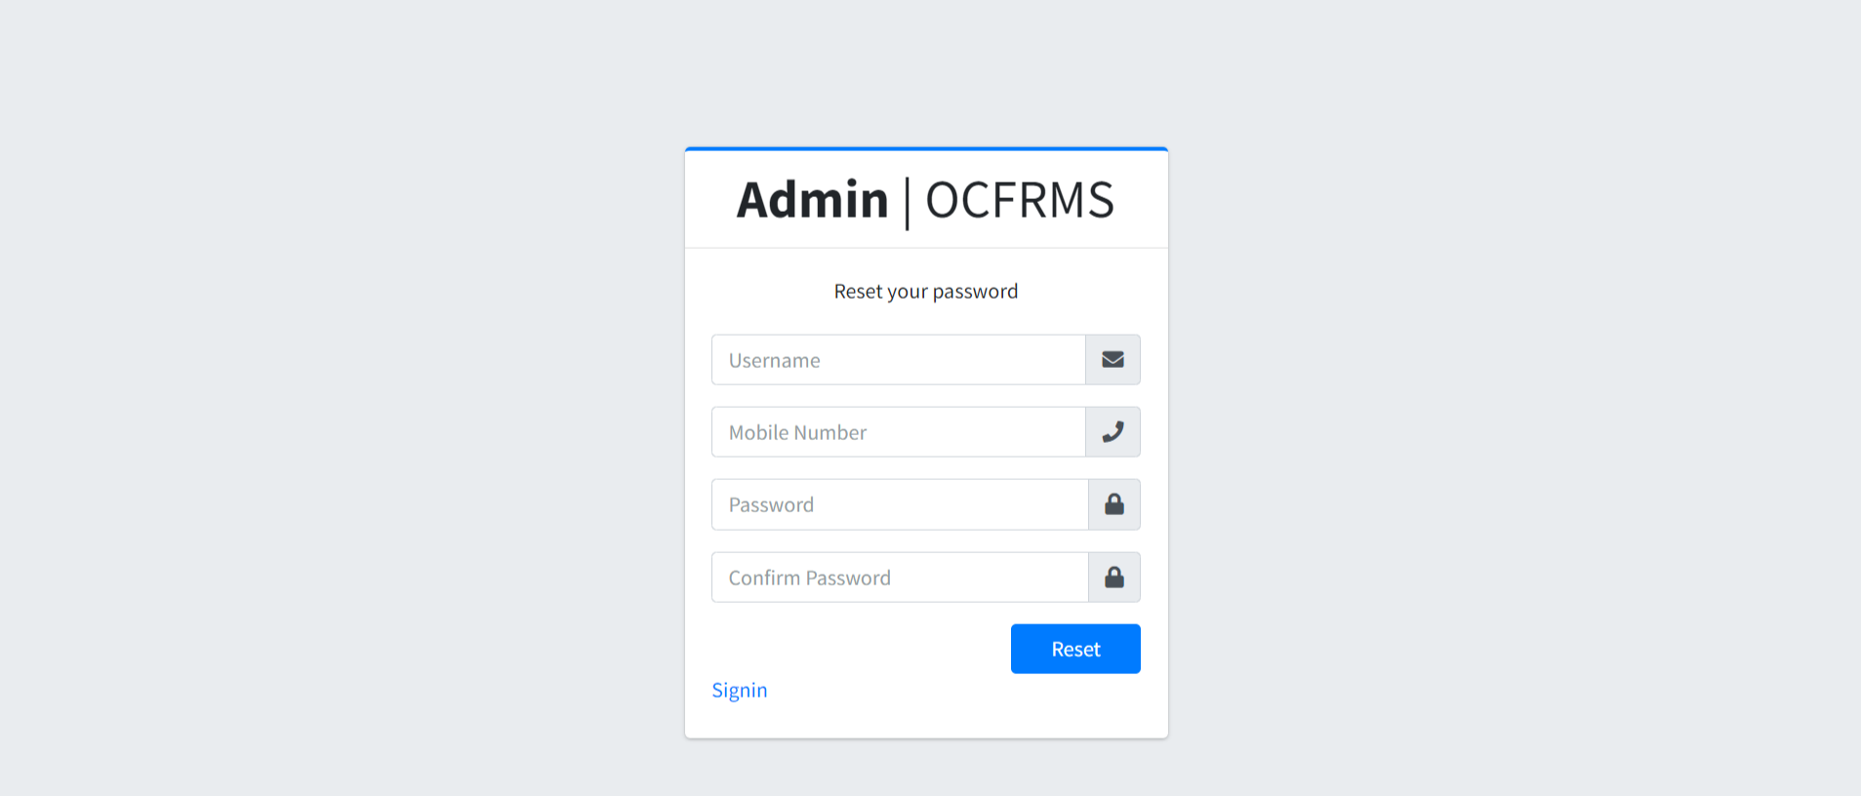

Slide 26
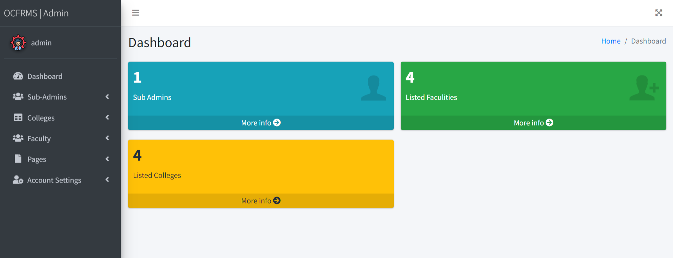
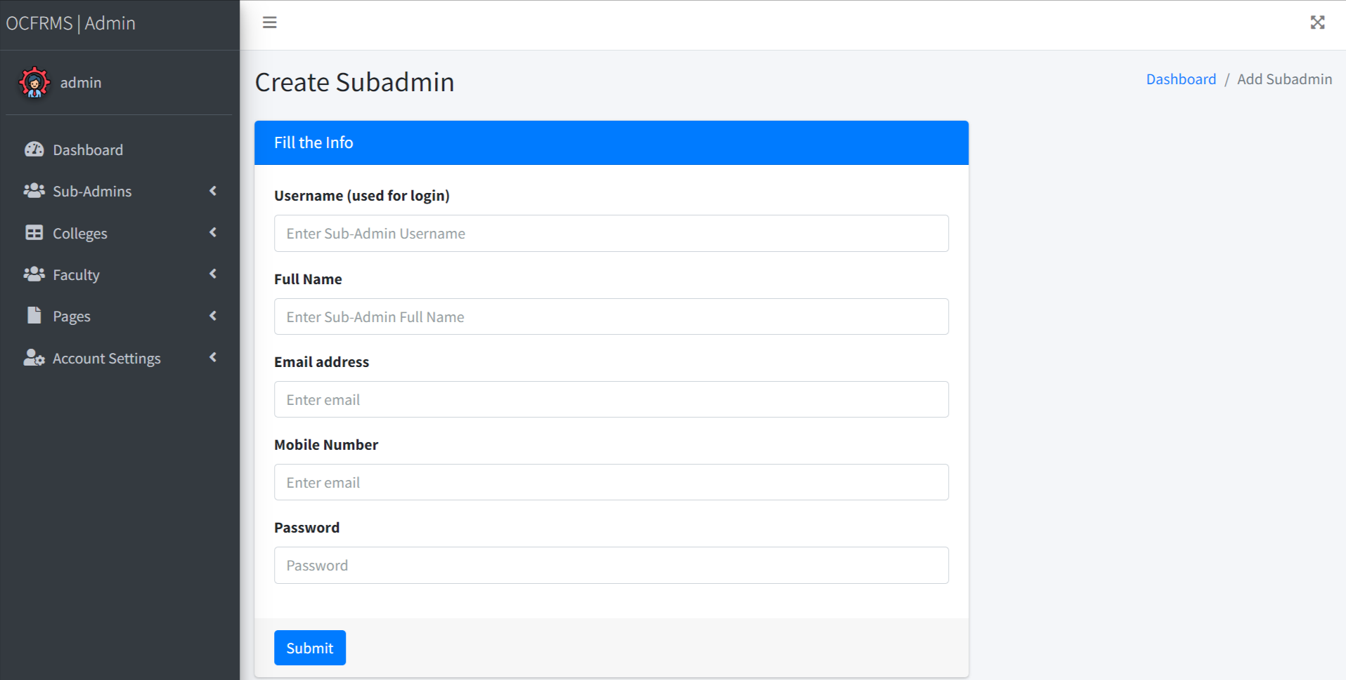

Slide 27
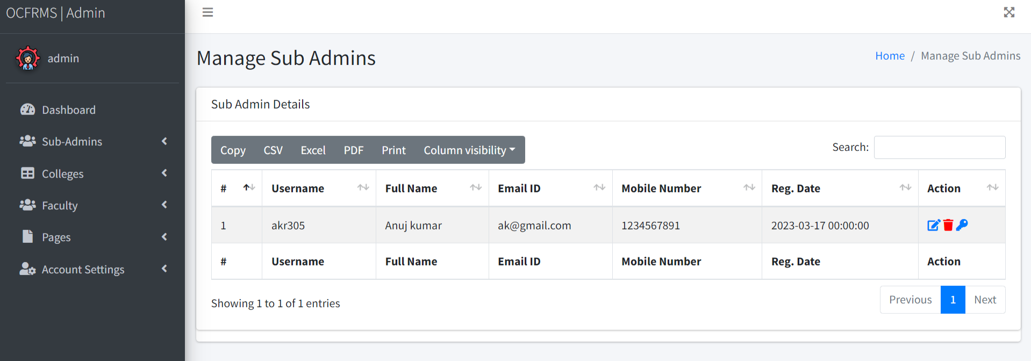
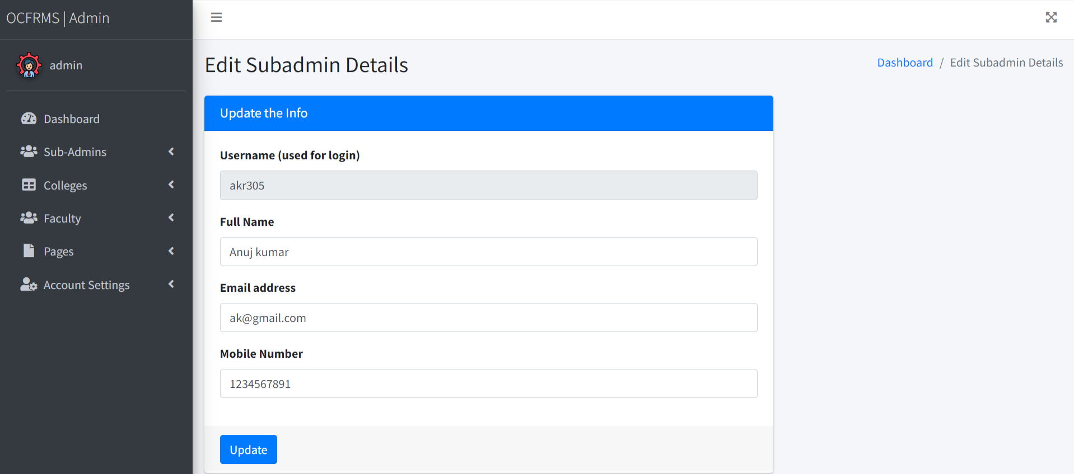

Slide 28
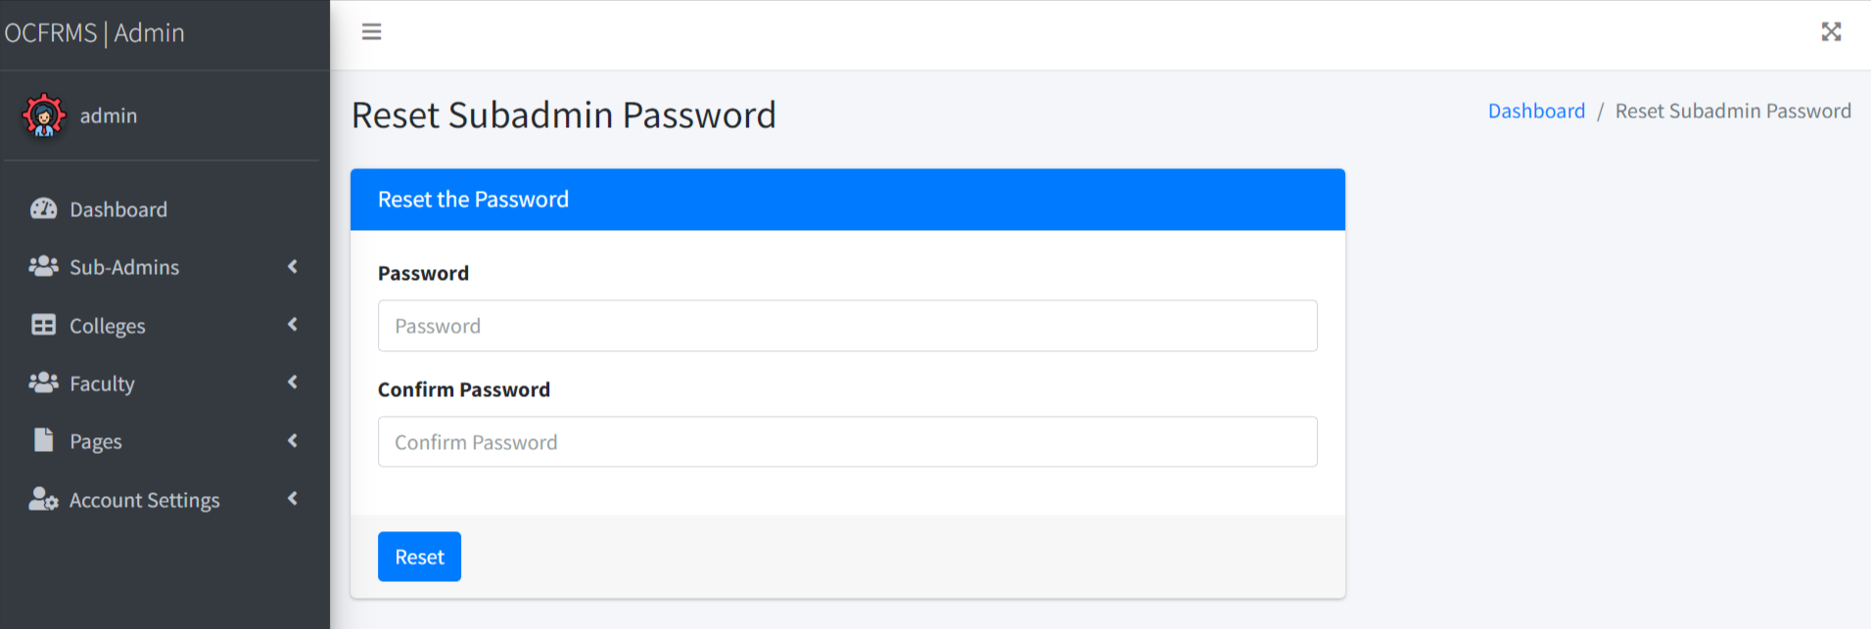
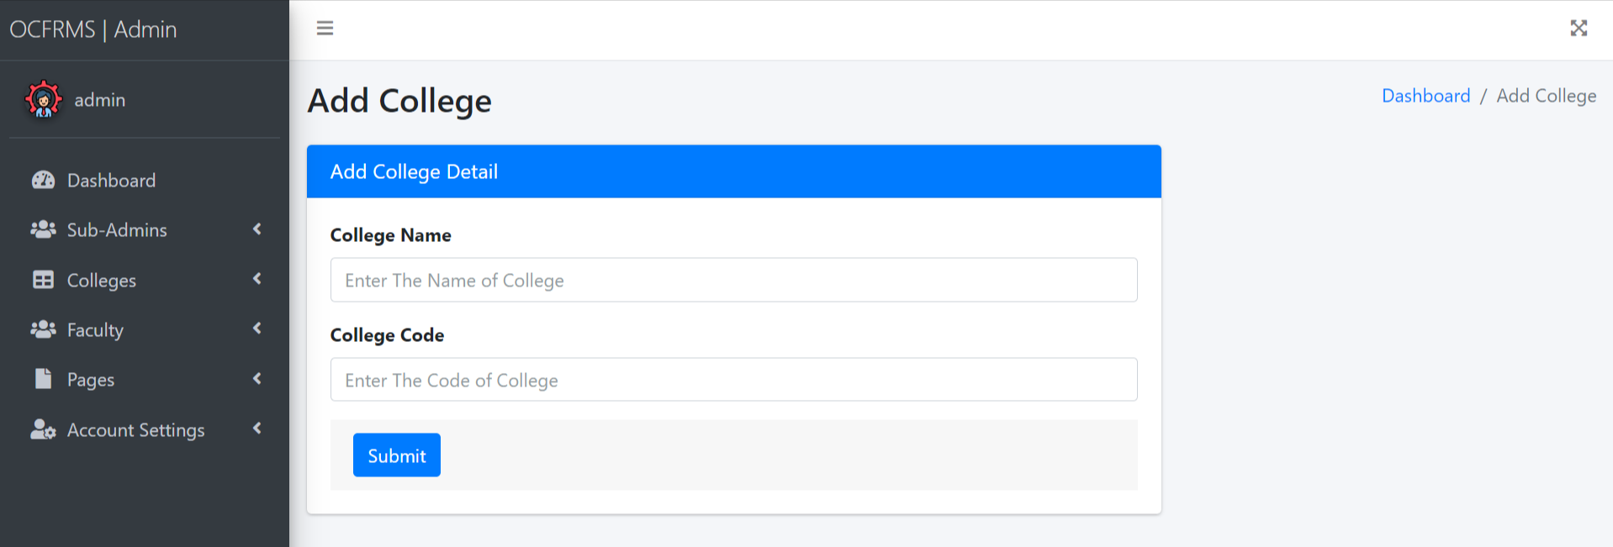

Slide 29
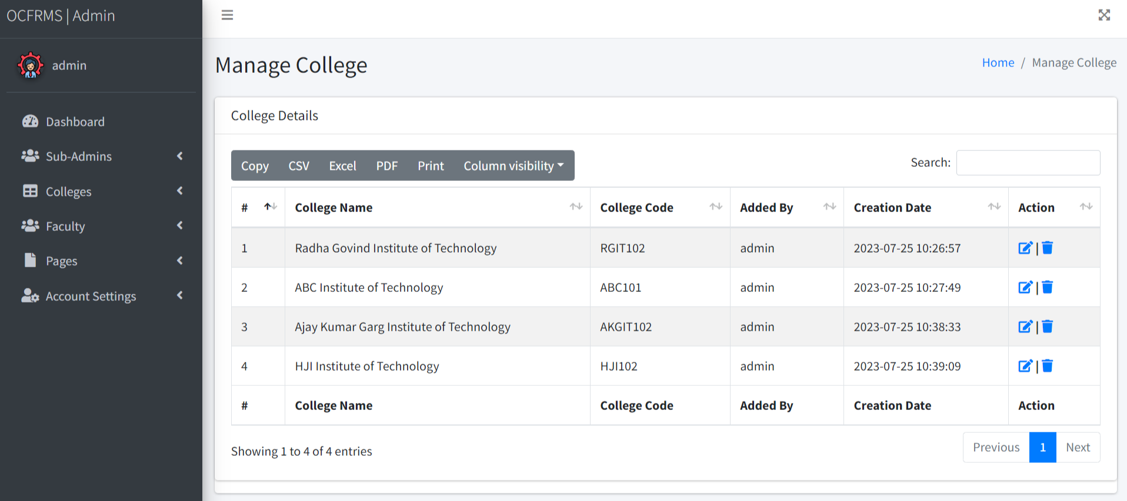
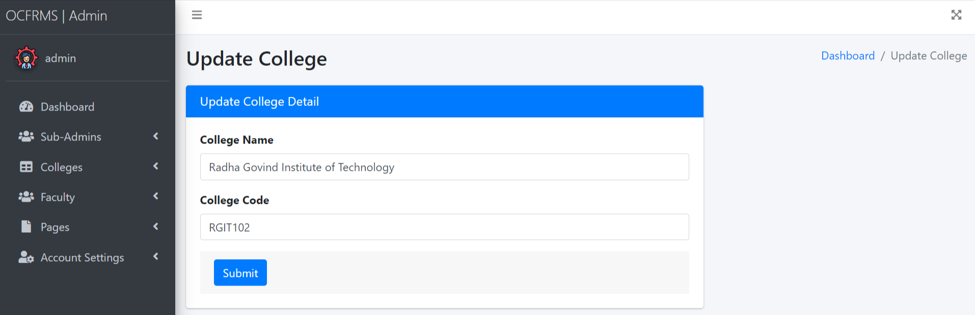

Slide 30
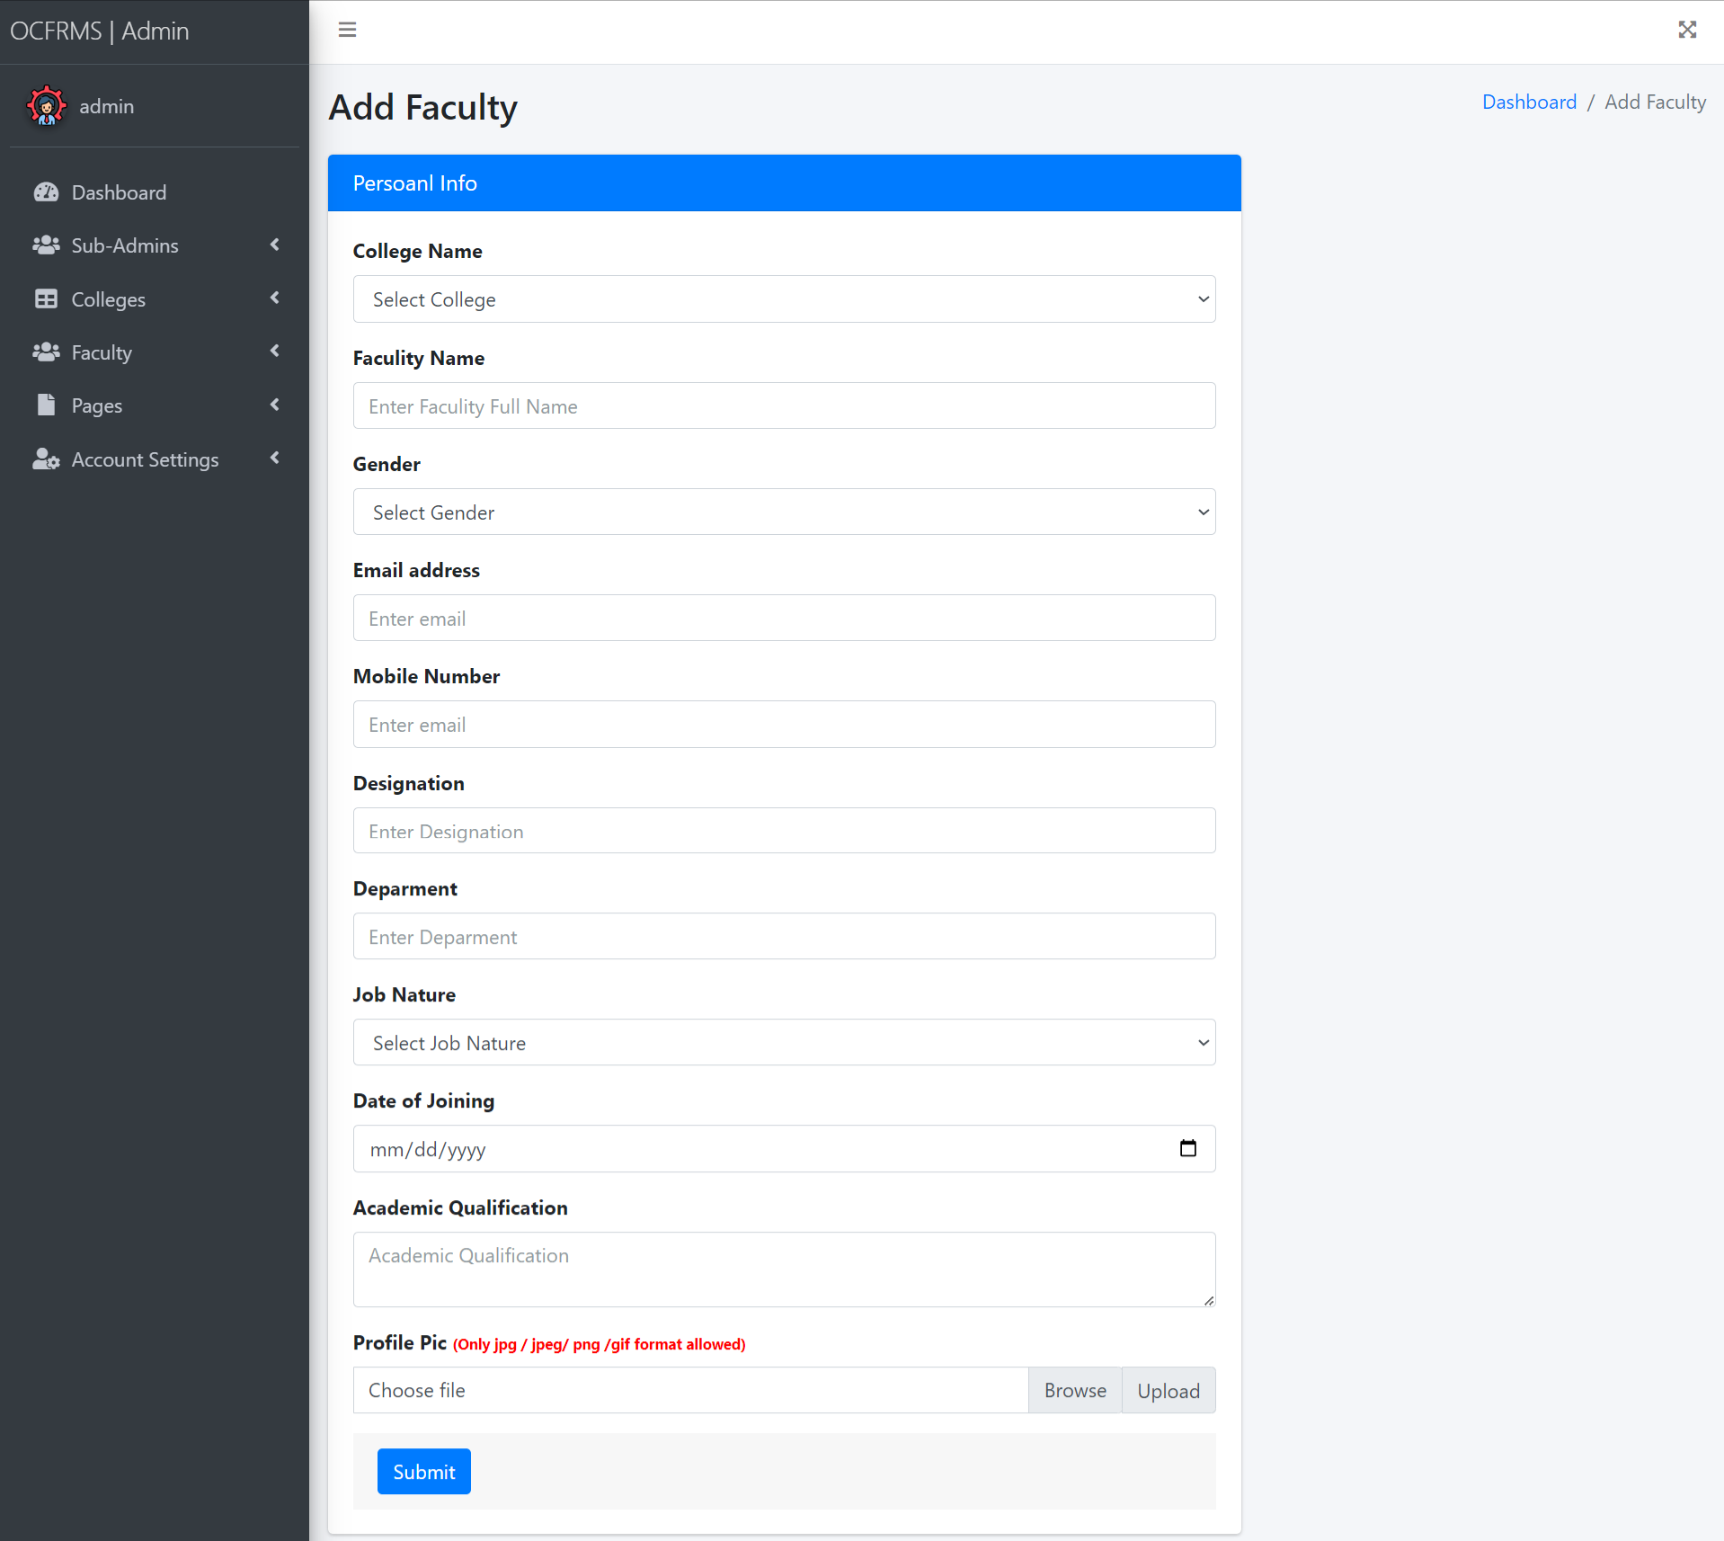

Slide 31
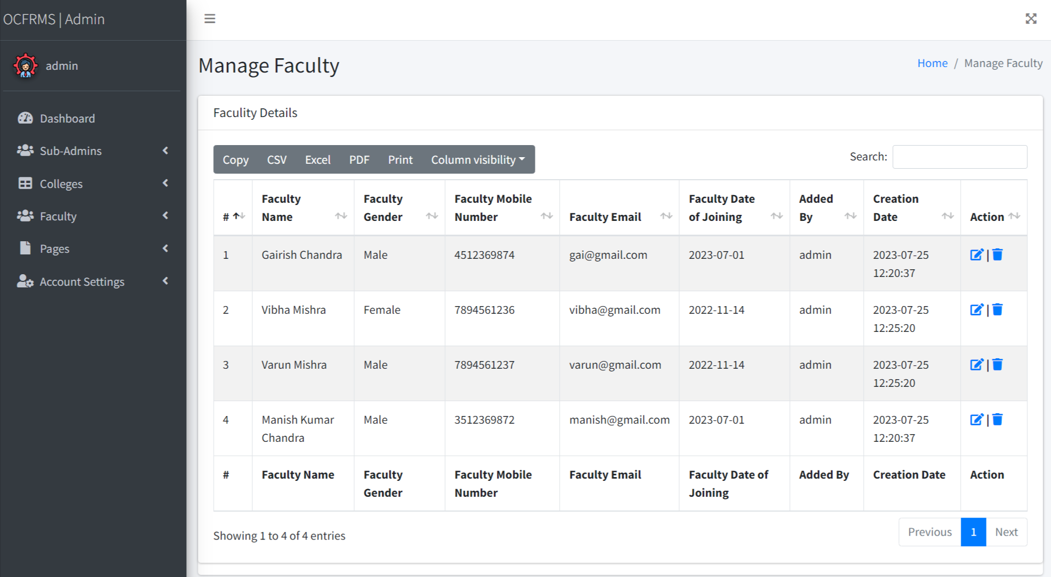

Slide 32
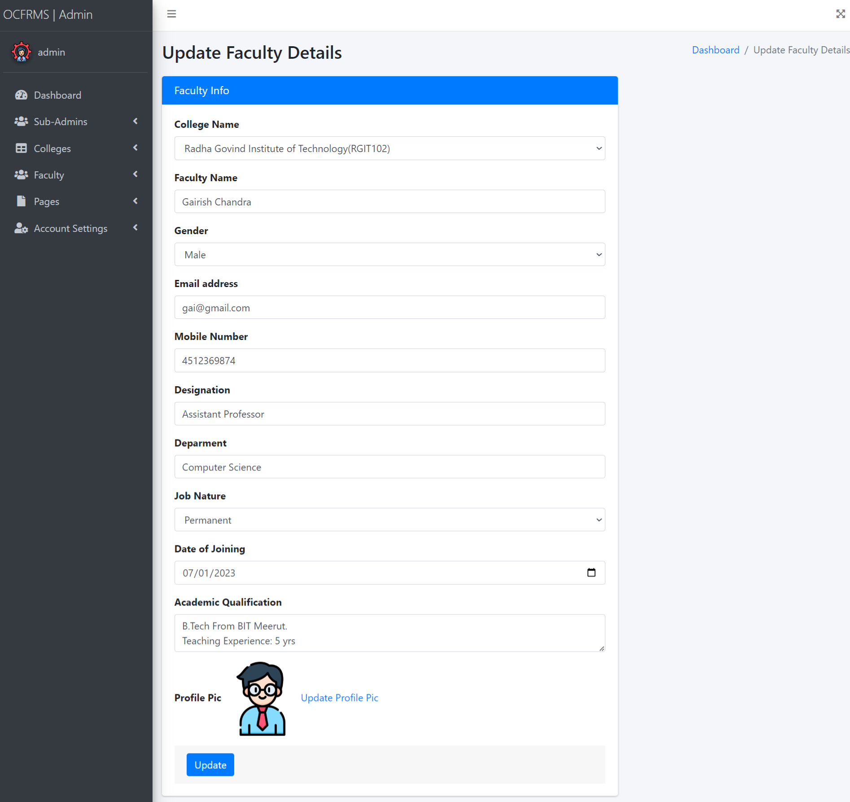

Slide 33
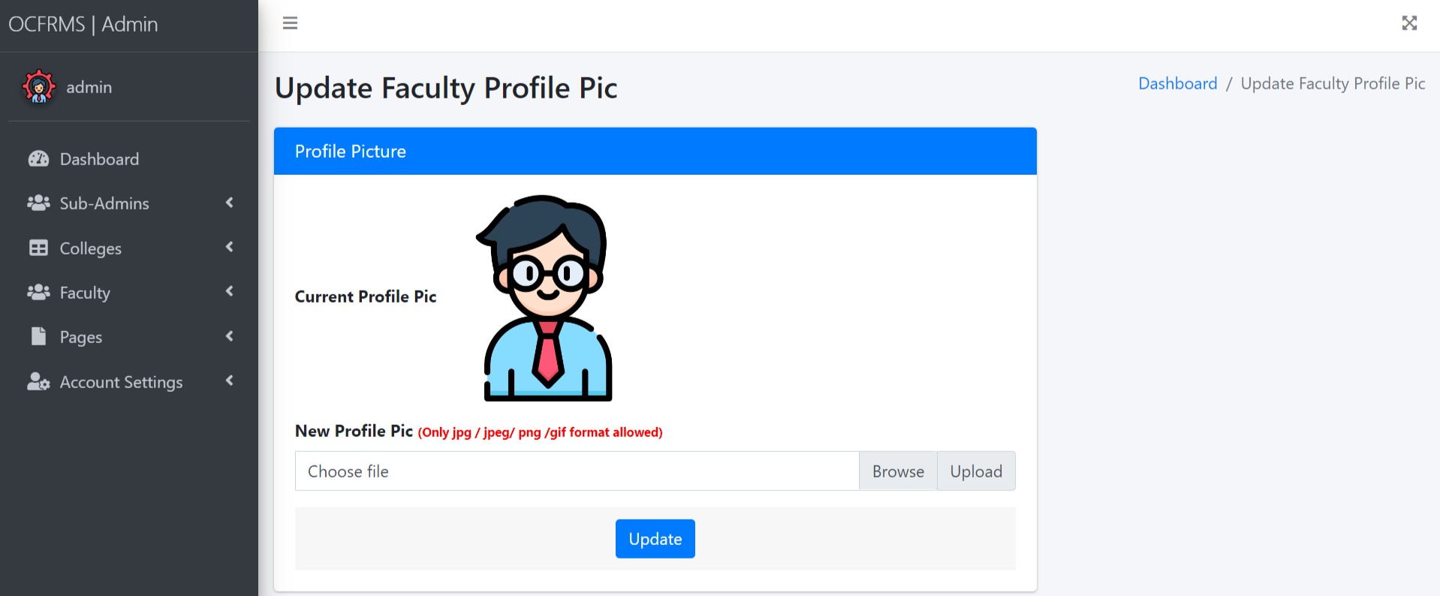
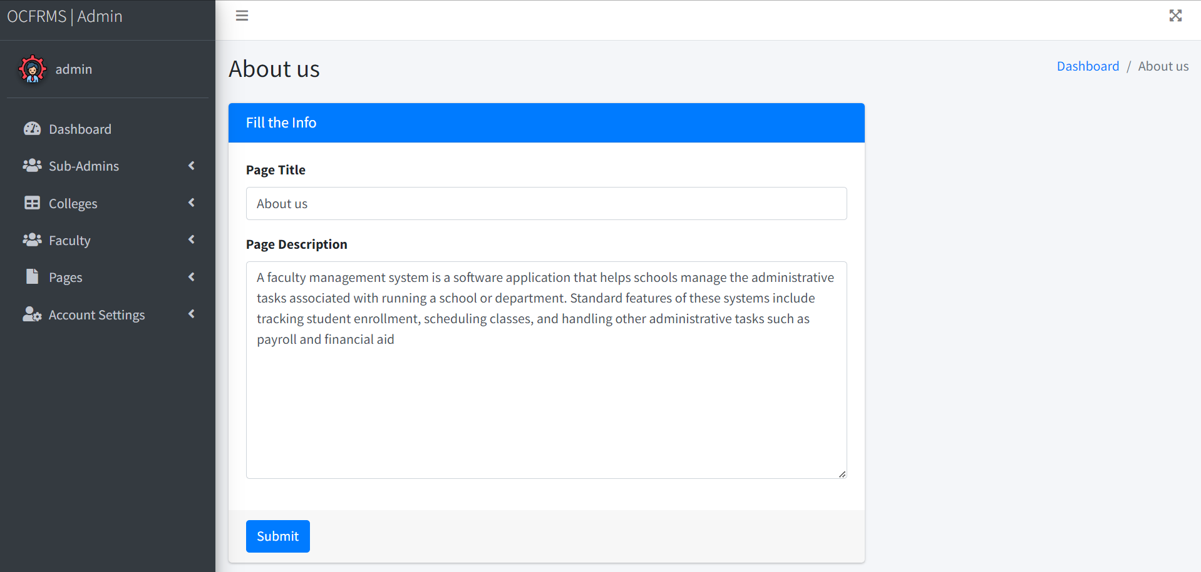

Slide 34
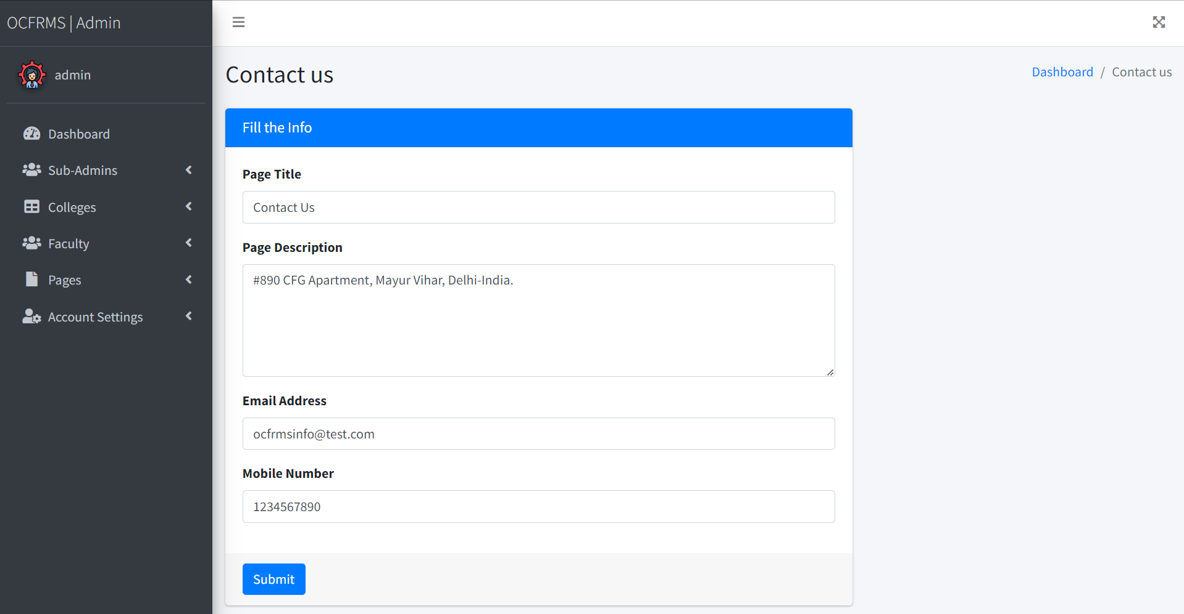
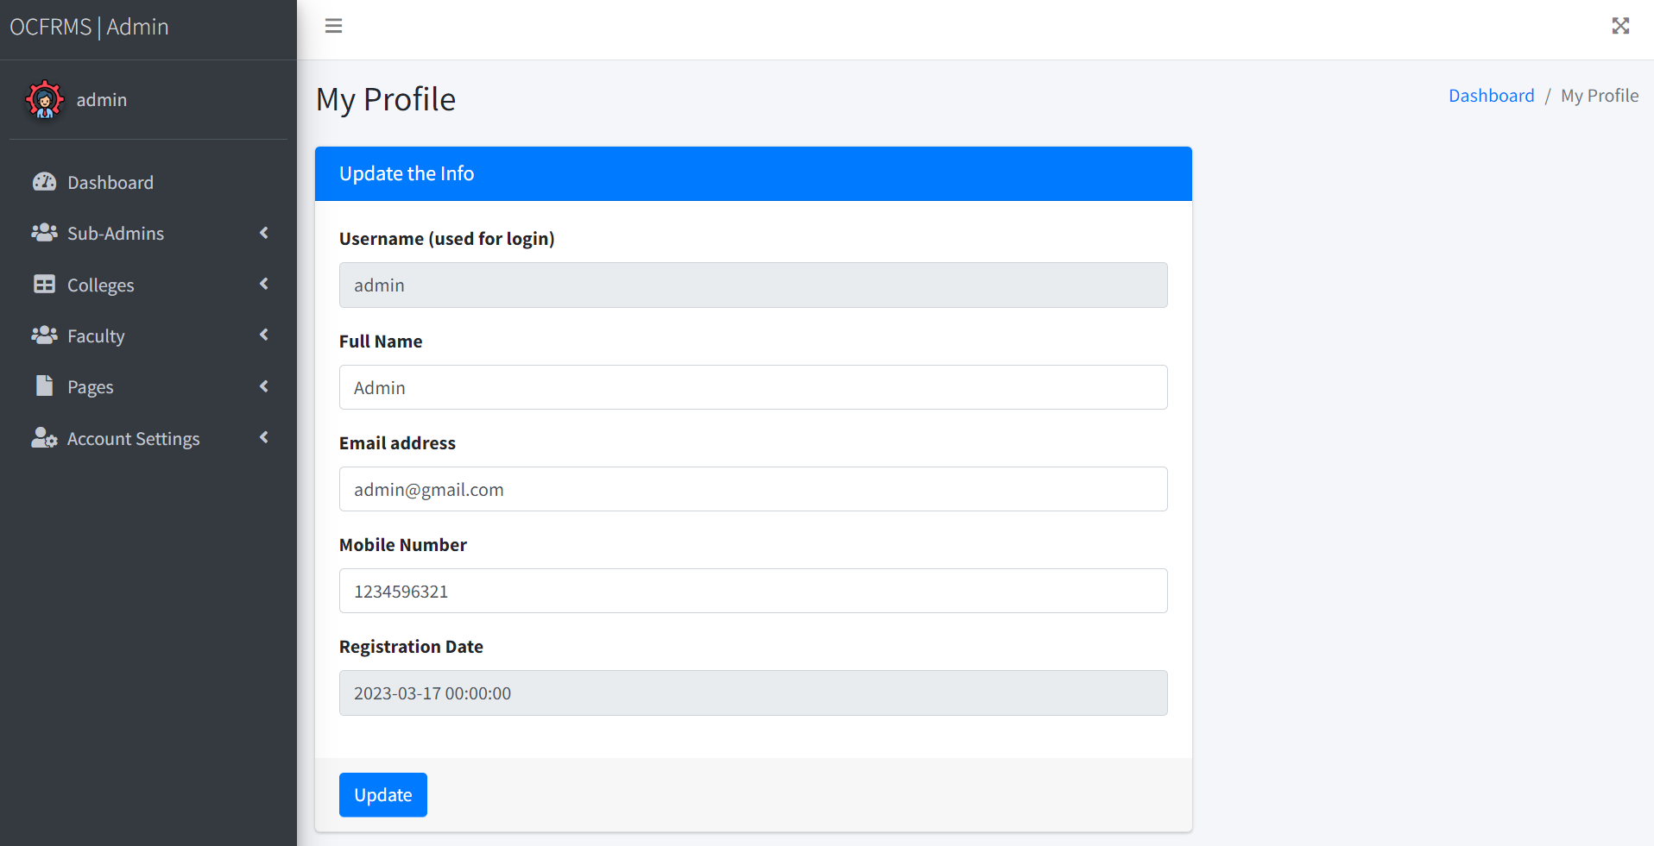

Slide 35
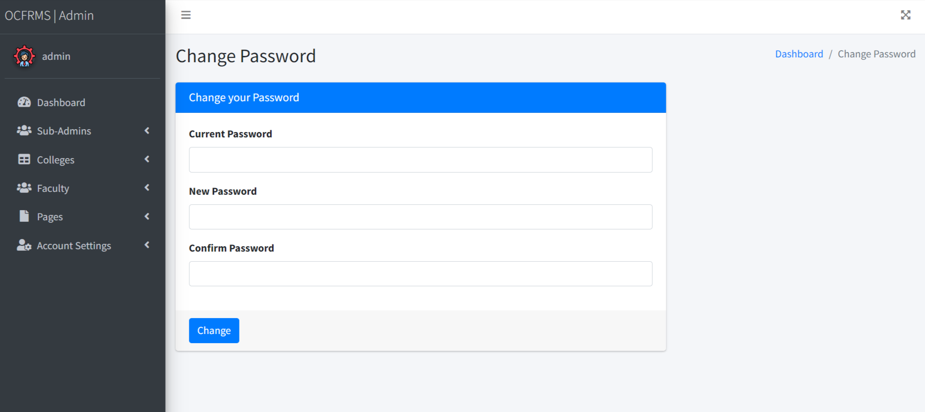

Slide 36
Conclusion
“Online College Faculty Records Management System “which is developed only for the stored the information about the Faculty in computer which is very easy to handle if the any person which is knows the English language perfectly who have no knowledge about any software that person can handle this system. Also can update, delete record of faculty and college.
The Application was designed in such a way that future changes can be done easily. The following conclusions can be deduced from the development of the project.
Automation of the entire system improves the productivity.
It provides a friendly graphical user interface which proves to be better when compared to the existing system.
It gives appropriate access to the authorized users depending on their permissions.
It effectively overcomes the delay in communications.
Updating of information becomes so easier.
System security, data security and reliability are the striking features.
The System has adequate scope for modification in future if it is necessary.

Slide 37
References
For PHP
https://www.w3schools.com/php/default.asp
https://www.sitepoint.com/php/
https://www.php.net/
For MySQL
https://www.mysql.com/
http://www.mysqltutorial.org
For XAMPP
https://www.apachefriends.org/download.html

Slide 38

Thank You

